Slide 1

OPTIMIZING IMPACT ON POWER GRID FOR FUTURE ELECTRIC VEHICLE TRENDS
OPTIMIZING IMPACT ON POWER GRID FOR FUTURE ELECTRIC VEHICLE TRENDS
Shubham Agrawal, Pratik Nagelia

Slide 2
Agenda
Introduction
Peak Load Minimization
Minimization of Load Variance in Power Grids
Conclusion
Current Trend in 2021

Slide 3
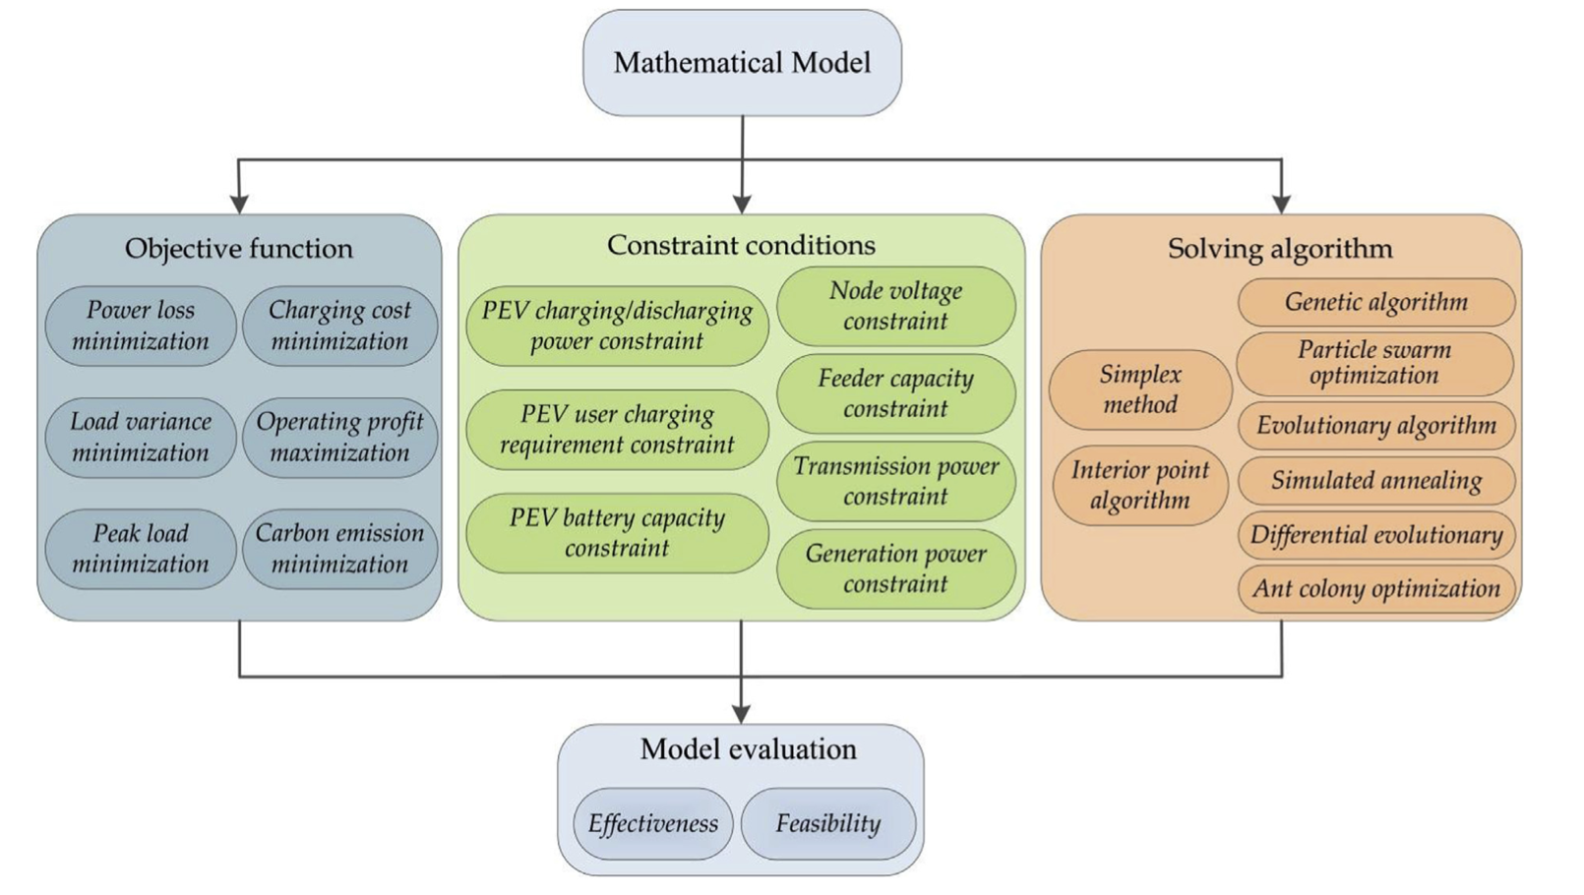
INTRODUCTION
Why do we need optimisations ? What kind of Optimisations ?

Slide 4
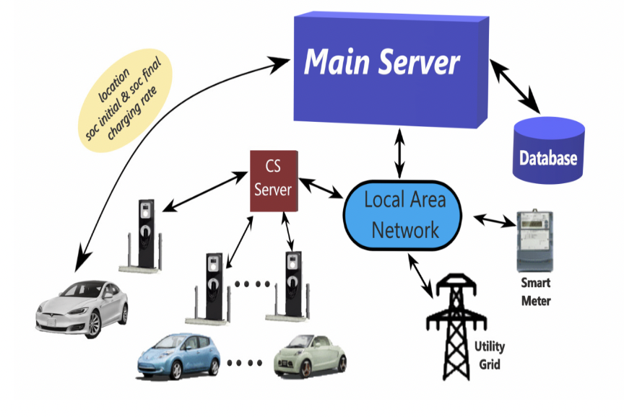
Proposed System Architecture for EV charging
EV Charging System :
- A main server and S substations.
- Ns charging stations in substation s ∈ S
- M ports in a charging station
- Local computer in each charging station
Main server :
- Compute Allowable EV loads for each charging station
- Determine EV position
Local computer in charging station

Slide 5
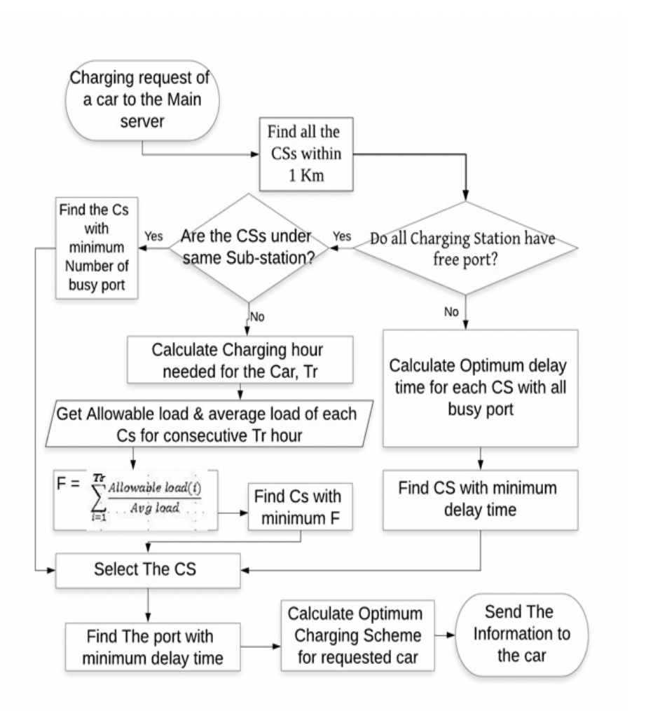
Flow Chart:
charging station selection for an EV sent request to main server

Slide 6
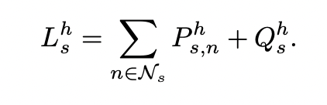
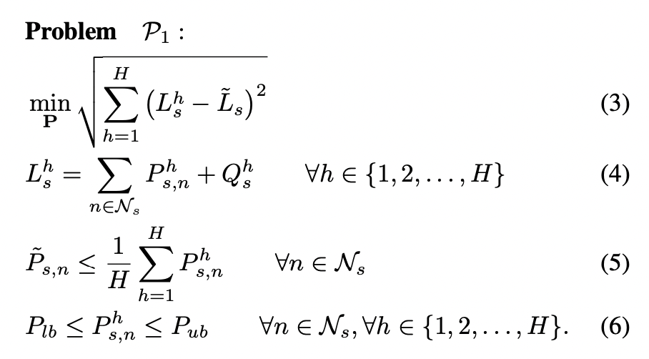
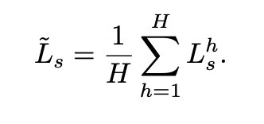
Peak Load Minimisation
The main objective of this problem is to reduce the peak loads at the substations by configuring the allowable loads at the different charging stations for EV charging for the 24 hours of a day.
Optimization problem to determine the allowable EV charging load at the h-th hour of a day
Lhs : Total Load at the substation s at h-th hour
Ph,sn : Allowable load at the for EV charging for a CS
Q h,s : Electric Load at substation s except the charging load
the average load L ̃s is given by
Where, H = 24

Slide 7
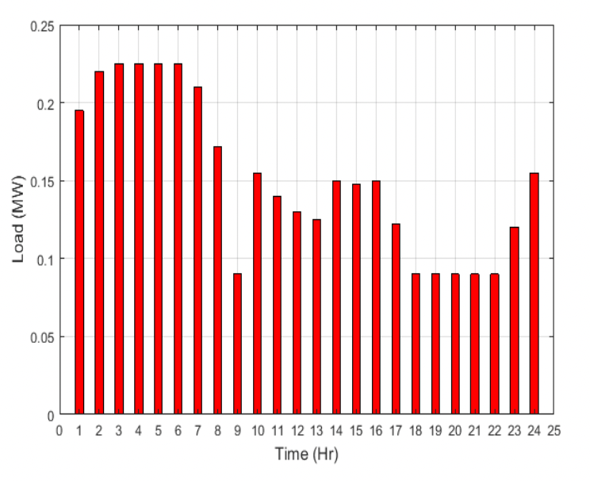
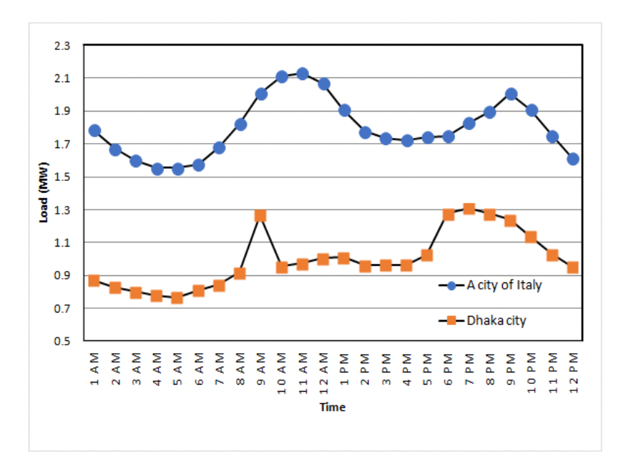
Results
Avg Charging Load : 15kw
EV penetration : 30%
Charging Ports : 2 - 3
Qs : Hourly Electric loads data from from a city in Italy and Dhaka
Allowable hourly loads for the first charging station of SS1.
Substation loads of two different cities
Allowable loads of a charging station are lower at the busy hours such that the peak load in the substations become lower

Slide 8
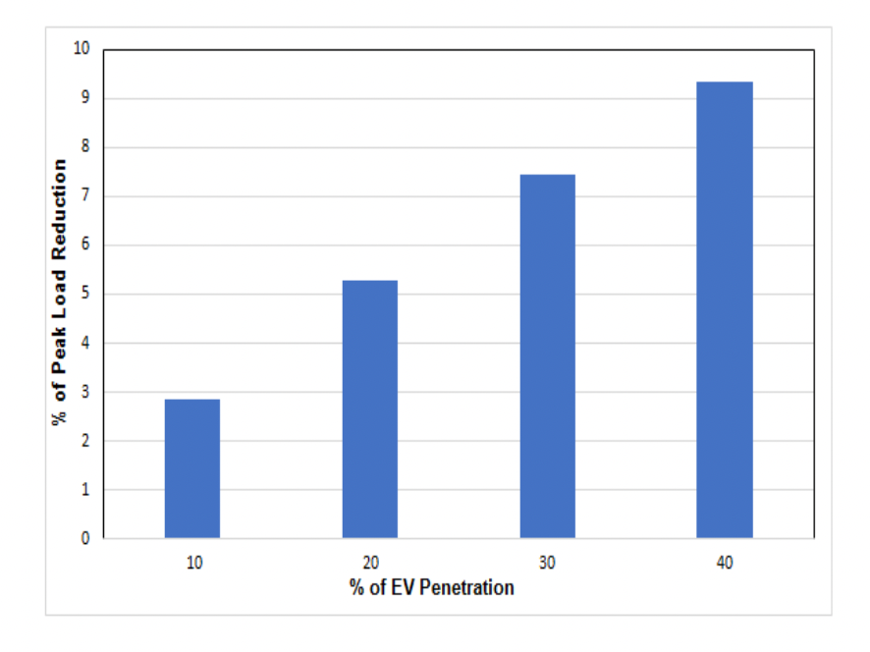
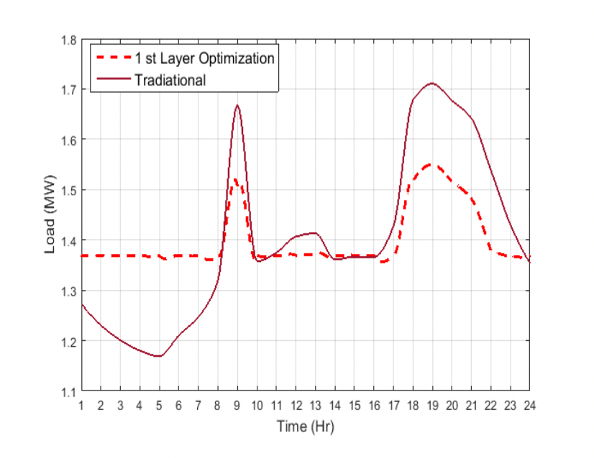
Results
The total load of the substation SS1 with and without optimizing the allowable load at the charging stations.
Reduction of peak load of the SS1 with increasing EV penetration.
results show that under the proposed method the total load of a substation increases at the off-peak hours and decreases at the peak hours.
Peak load reductions around 7.5% and 5.5%
peak load reduction significantly increases with increasing the EV penetration

Slide 9
Results & Conclusion
The proposed method decreases peak load about 14% with respect to the traditional uncoordinated charging.
There are multiple other factors into play which might pop up with the practical implementation of it.
Simulation is performed considering type-C charging port which take longer time to charge EV batteries.
Tesla Fast chargers which can charge up to 80% within 1 hour, but the proposed method is applicable for those chargers too.
The numerical results show that a significant amount peak load shaving can be achieved by using the proposed method and the percentage of peak load reduction increases with increasing the EV penetration.
Now let us look into Another method of Load Variance Minimisation.

Slide 10
Part 2
Minimization of Load Variance in Power Grids
Goal: Investigating an Optimal Vehicle to Grid/ Grid to Vehicle Scheduling:
This is achieved by allowing electric vehicles charging (grid-to-vehicle) whenever the actual power grid loading is lower than the target loading, while conducting electric vehicle discharging (vehicle-to-grid) whenever the actual power grid loading is higher than the target loading.
Concept:
Vehicle-to-Grid (V2G) technology
Target Load
Power Grid Load
Capability of the grid-connected electric vehicles

Slide 11
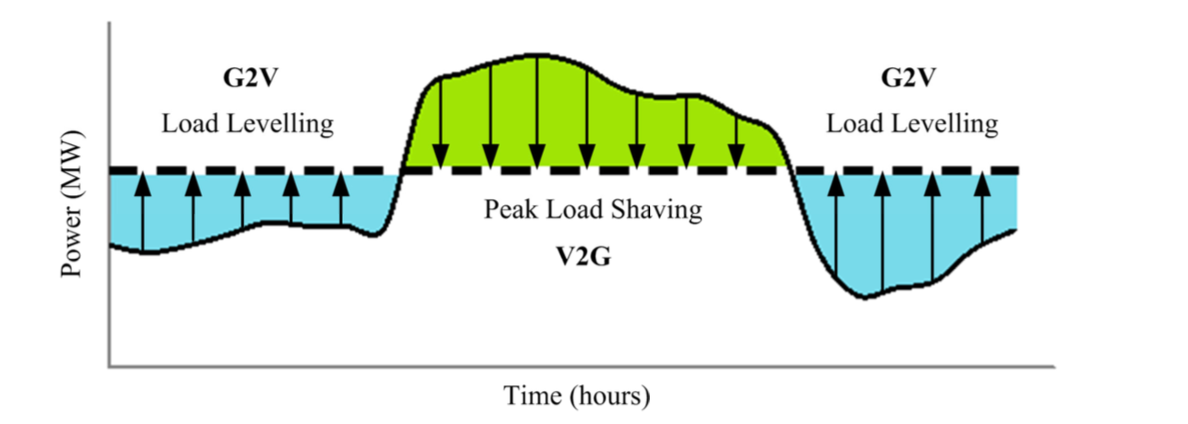
Problem Statement
Fig: Generalised daily power load curve showcasing concept of peak load shaving and load levelling

Slide 12

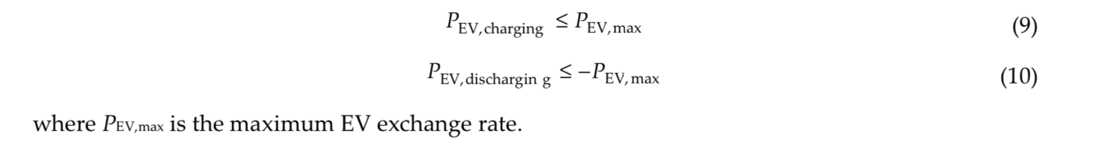
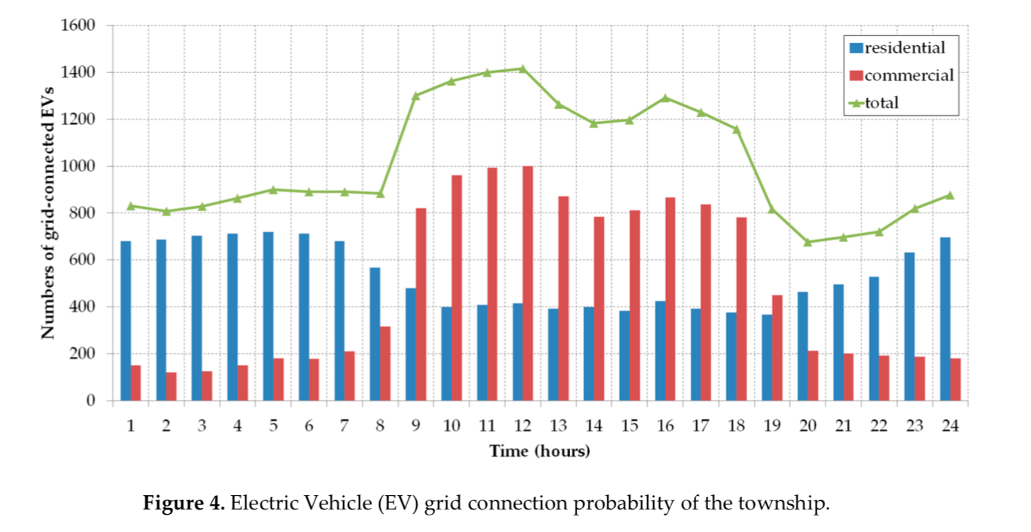

Constraints
3. EV Power Exchange Rate
State of Charge (SOC)
2. EV Grid Connection Probability:
4. Planning

Slide 13
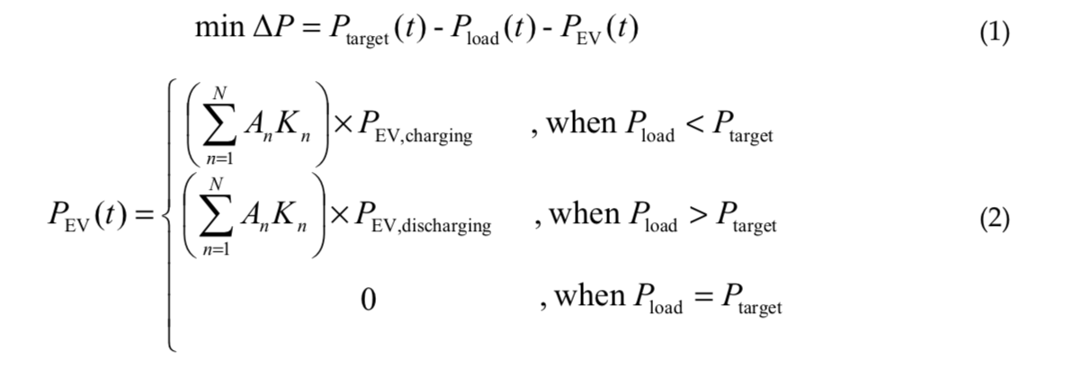
Objective Function
where ∆P is the grid load variance, t is time, Ptarget is the target loading, Pload is the existing load of the power grid, PEV is the total power of EV loads/sources, n is the EV index, N is the maximum EV index, An is the availability of nth EV for the V2G application, Kn is the indicator of nth EV for V2G application, PEV,charging is the EV charging rate, and PEV,discharging is the EV discharging rate. In Equation (1), the grid load variance (∆P) was minimized by optimizing the number of grid-connected EV to charge or discharge during valley load and peak load period, respectively. In the condition where Kn and An are available, the nth EV will be instructed to charge or discharge the battery.

Slide 14
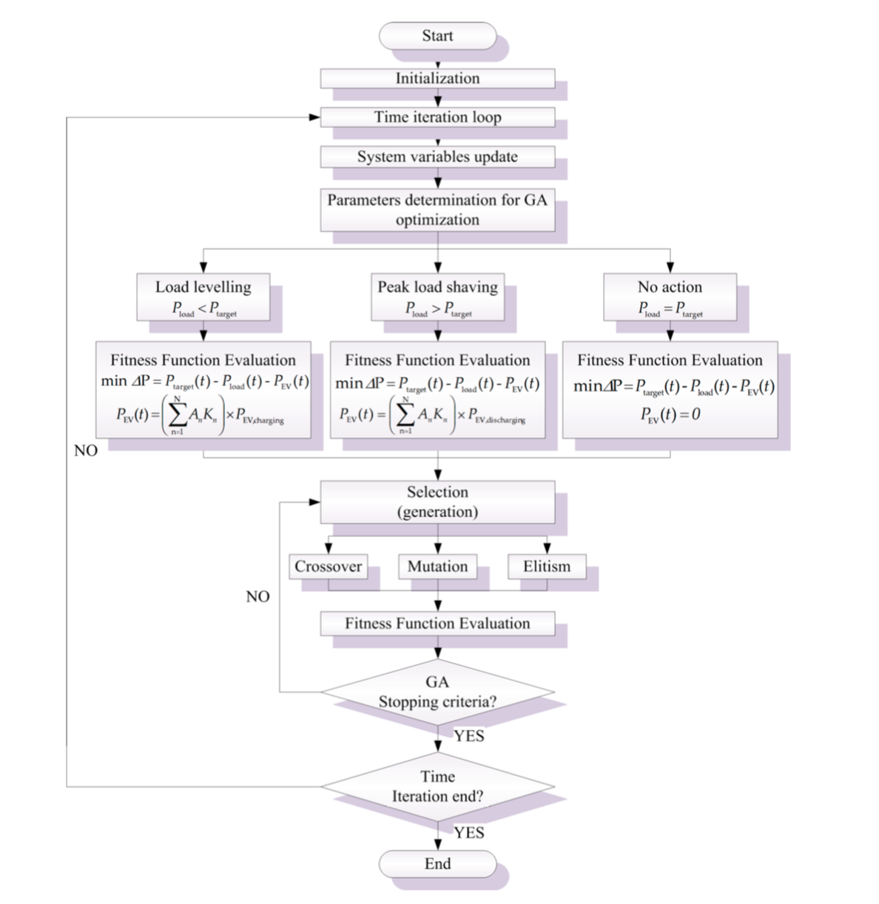
Genetic Optimization
Algorithm

Slide 15
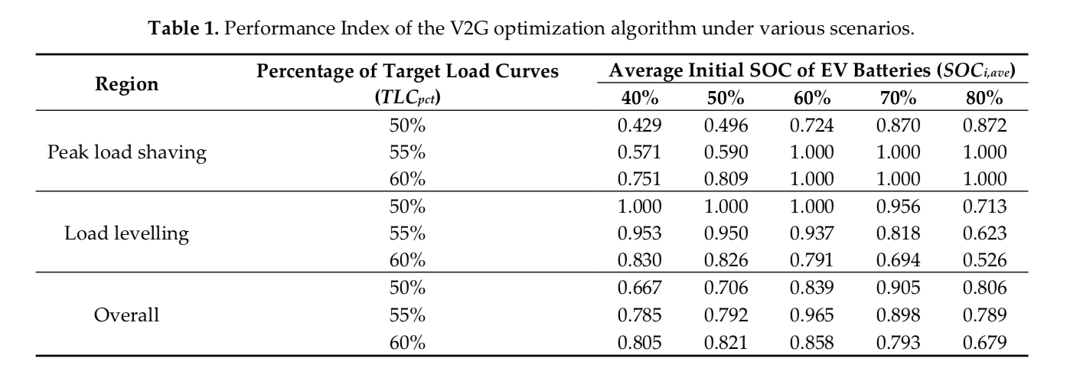
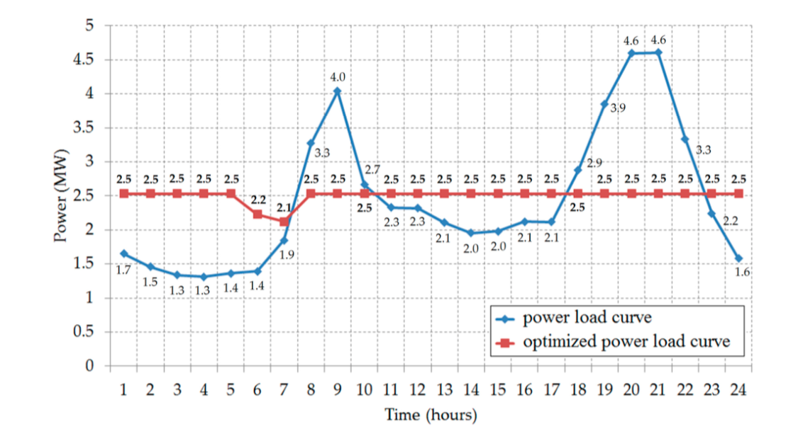
Results

Slide 16
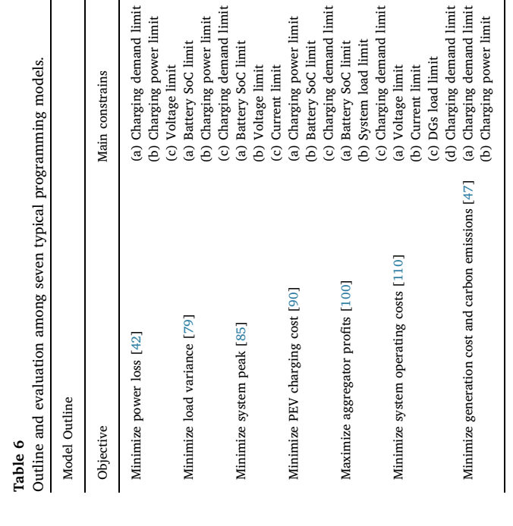
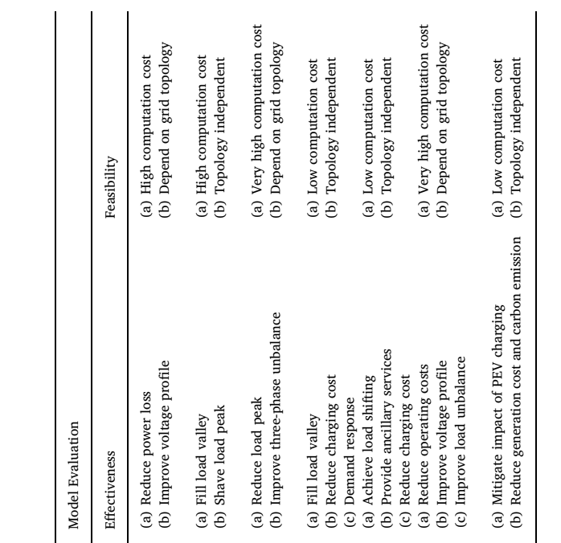
Conclusion

Slide 17
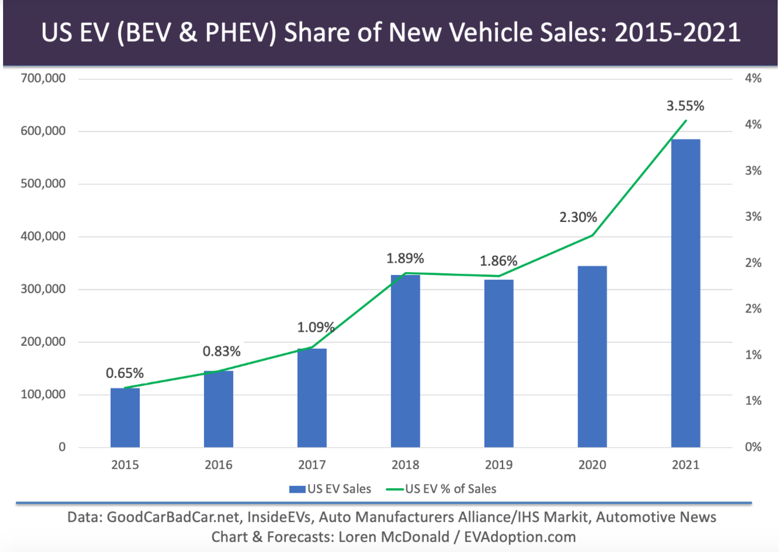
Current Trend - 2021
1. Government Initiatives and Incentives
2. Surge in EV sales
3. Improving Range and Charge for new EVs
4. Expanding EV Charging Station Infrastructure
5. Home EV Charging Stations More Efficient Than Ever

Slide 18
Thank You

Slide 19

Part 1
Peak Load Minimization
P_{t}^{PV} : indicates the power supply of the photovoltaic array at time t
P_{t}^{Conn} : represents the conventional loads without PEVs at time t
P_{t,n}^{EV} : represents the charging power of the n-th PEV at time t
T represents the divided number of time period
N represents the number of PEVs.

Slide 20
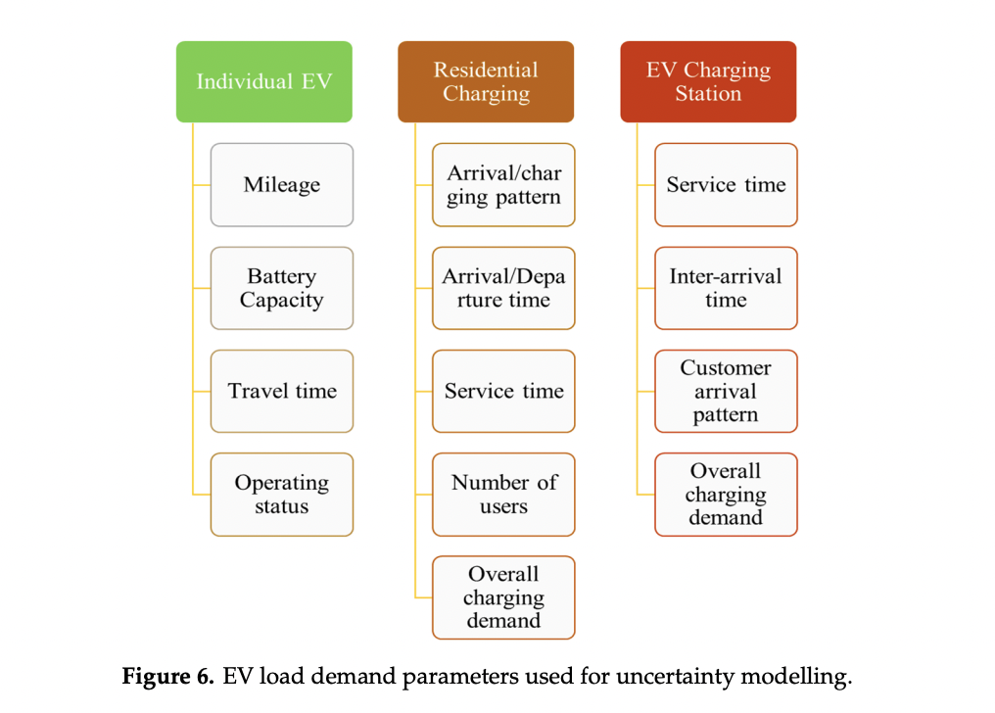
EV Load Demand Parameters

